Slide 1
Product Overview & Overall Description
Detonating Baby Felines is a turn-based card game where the goal is to knock other players out of the game. We aim to move this card based game from physical to the digital space, so that users can enjoy this game with players around the world.

Slide 2
Product Functionality, Assumptions & Dependencies
Functionalities include:
A lobby that displays available games and ability to create new game
The game state is maintained in real time
The user shall be able to draw a card and play valid cards
The system provides intuitive feedback
The user can watch game after death
Assumptions & Dependencies:
Card game is turn based and operates in a stateful way
Users have access to the internet
Web project that should work on all browsers
There are no time sensitive actions in gameplay

Slide 3
Specific Requirements - User Interfaces
Lobby Screen: This is the user interface that shall list all active games the user is a part of. Clicking on an active game should send them to the Gameplay Screen. This screen also allows the user to create or join a new game.
Gameplay Screen: This is the user interface that will allow the user interact in the game.

Slide 4
Specific Requirements - Software Interfaces
The client shall connect and communicate to the server side software. The server side software shall handle the state and move validation of the game, the client-side software is for communicating with the server and displaying the game only.

Slide 5
Functional Requirements
F1: The system shall allow users to load the lobby
F2: The lobby shall display list of games available to join
F3: The system shall allow user to create a game with 2-5 players with a name
F4: The user shall be able to join a game
F5: The user shall be able to quit any game they have joined
F6: The system shall maintain game state cross-client in real time
F7: The system shall maintain game state in database
F8: The system shall notify user when it is their turn
F9: The user shall be able to draw a card
F10: The user shall be able to play a valid card or cards
F11: The system shall not let players see contents of deck, unless specific card allows for it
F12: The system shall provide feedback messages to the users, such as warnings of game status change events.
F13: The user shall be able to have active status disabled upon death condition

Slide 6
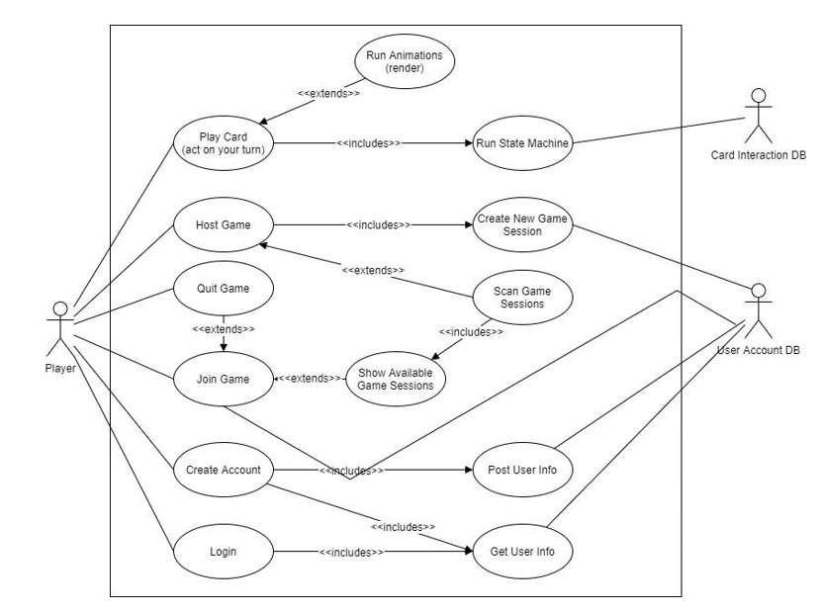
Use Case Model

Slide 7
Other Non Functional Requirements
Performance Requirements:
P1: The system shall work on all browsers
P2: The system shall work with 20 users at the same time with no discernable impact on performance
P3: Page load (From a user perspective) should be less than 3 seconds

Slide 8
Software Quality Attributes
Availability: The backend services shall be available and accept connections 95% of the time.
Usability: The user interface shall be simple, intuitive and easy to use.
Reliability: The system should perform and store all game moves on the first try. The system should never get confused about whose turn it is, what card have been played etc
Integrity: The data from the user game session shall not cross-pollinate with another game session the user has active

